Slide 1
Web Engineering
CSS

Slide 2
CSS
CSS stands for Cascading Style Sheets
CSS describes how HTML elements are to be displayed on screen.
CSS is the language we use to style an HTML document.

Slide 3
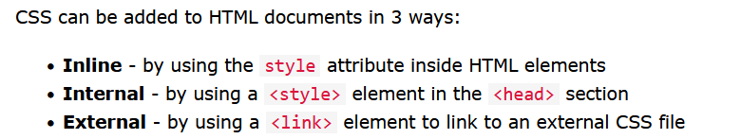
HTML CSS
Cascading Style Sheets (CSS) is used to format the layout of a webpage.

Slide 4
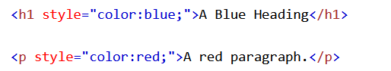
Inline CSS
<h1 style="background-color:powderblue;">This is a heading</h1>
<p style="background-color:tomato;">This is a paragraph.</p>

Slide 5
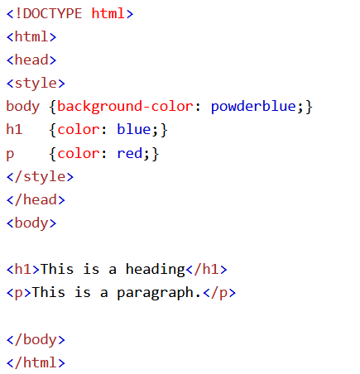
Internal CSS

Slide 6
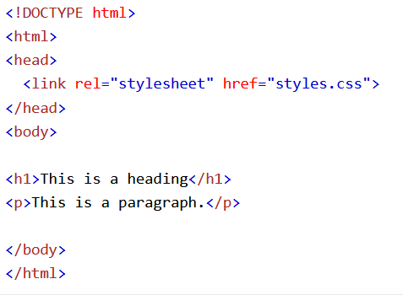
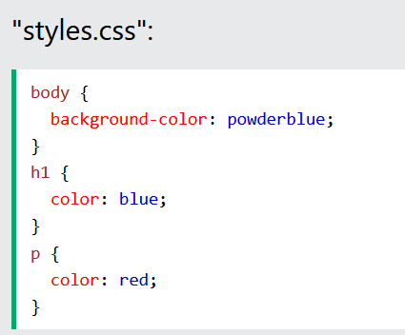
External CSS

Slide 7
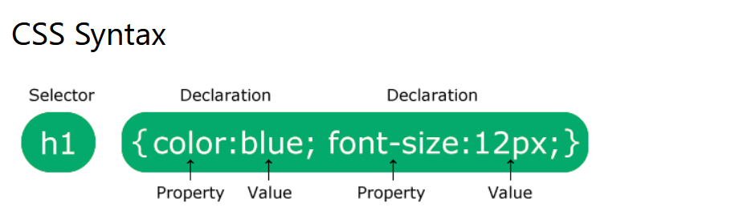
CSS Syntax

Slide 8
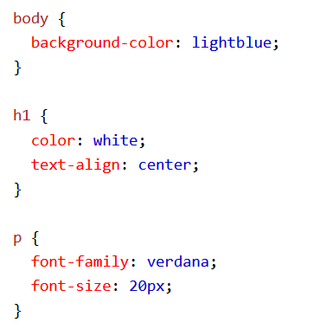
Example

Slide 9
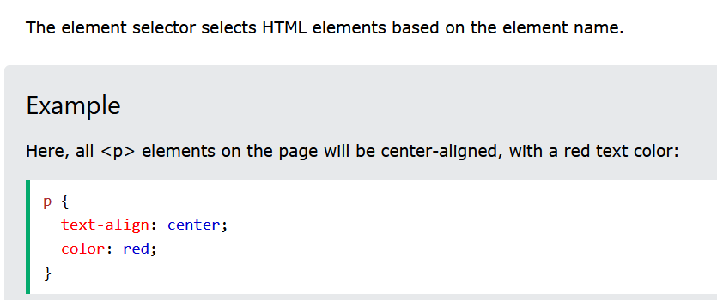
CSS Selectors: Element Selector

Slide 10
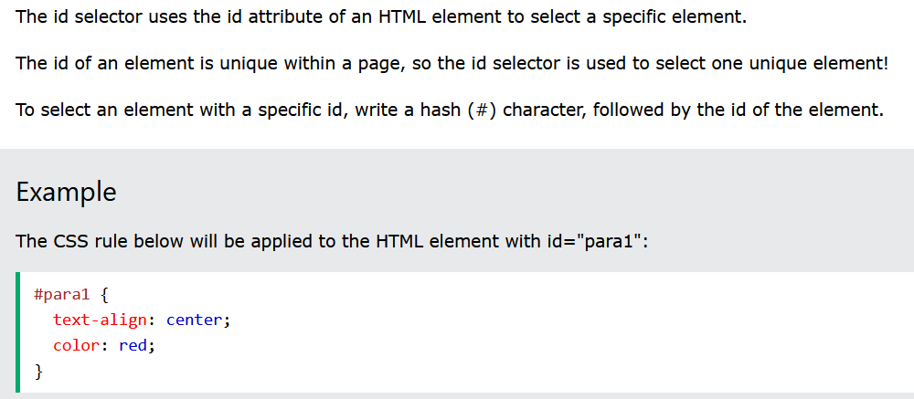
Id Selector

Slide 11
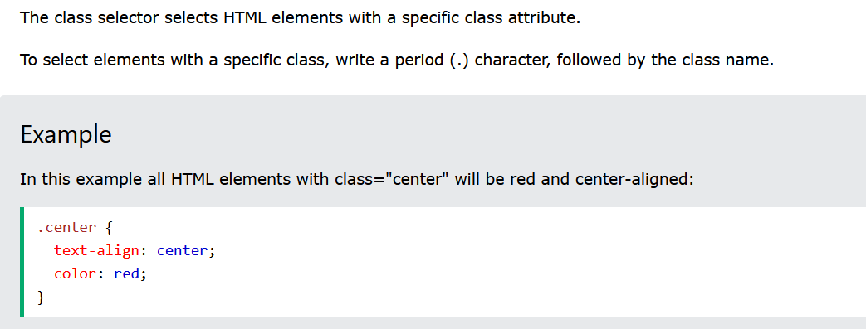
Class Selector

Slide 12
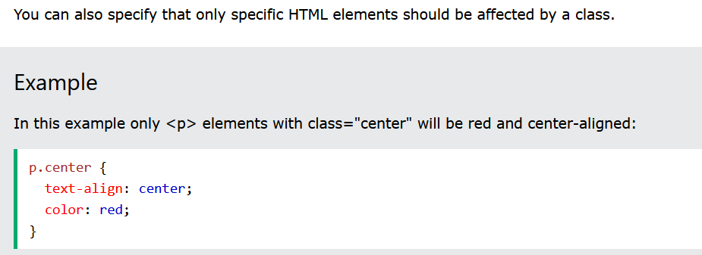
Class Selector

Slide 13
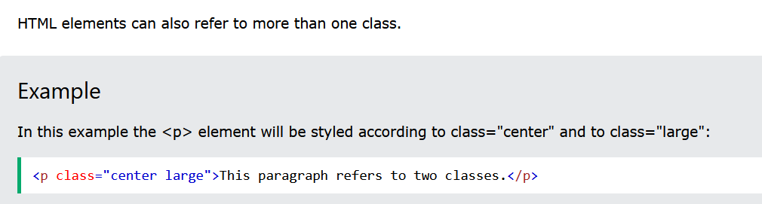
More than one class

Slide 14
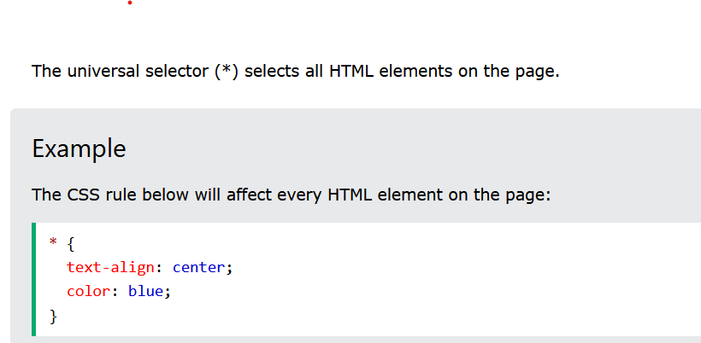
Universal Selector

Slide 15
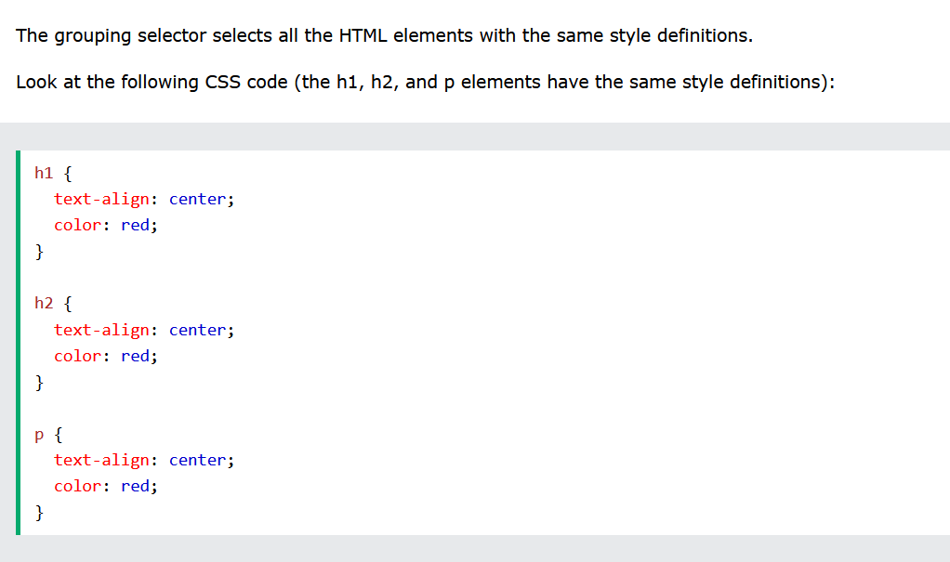
Grouping Selector

Slide 16
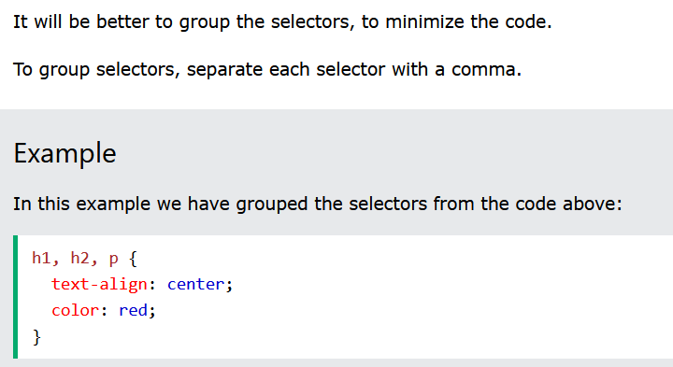
Grouping Selector

Slide 17
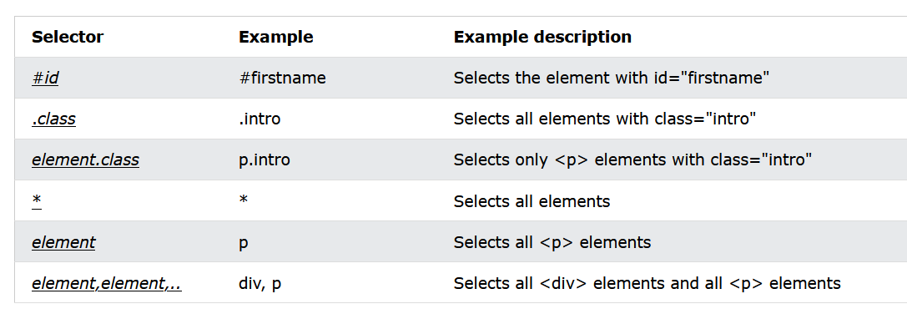
All CSS Simple Selectors

Slide 18
References
https://www.w3schools.com/css/css_selectors.asp

Slide 19


